Slide 1

Leo wong
Shanghai
OCT 2016
8

Slide 2
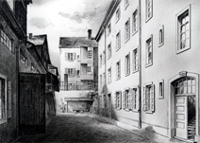
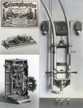

Robert Bosch the entrepreneur, engineer
Rebel?
Robert Bosch (1861-1942）
30
Notes:
Carl Friedrich Goerdeler
The administrative lawyer Carl Friedrich Goerdeler was lord mayor of Leipzig from 1930 to1936, making him one of only a handful of municipal leaders who were not members of the Nazi Party. After his resignation, he worked for Bosch as a liaison to the city government in Berlin. It was this position that permitted him to play an active role in the resistance against the Nazi regime. As the cofounder of the civilian underground opposition against the Nazi regime, Goerdeler formulated new constitutional plans and blueprints for a European Union. After the failed assassination attempt of July 20, 1944, Goerdeler, who was designated to become the new Chancellor, was executed as a "traitor" and "war spy" in Berlin on February 2, 1945.

Slide 3
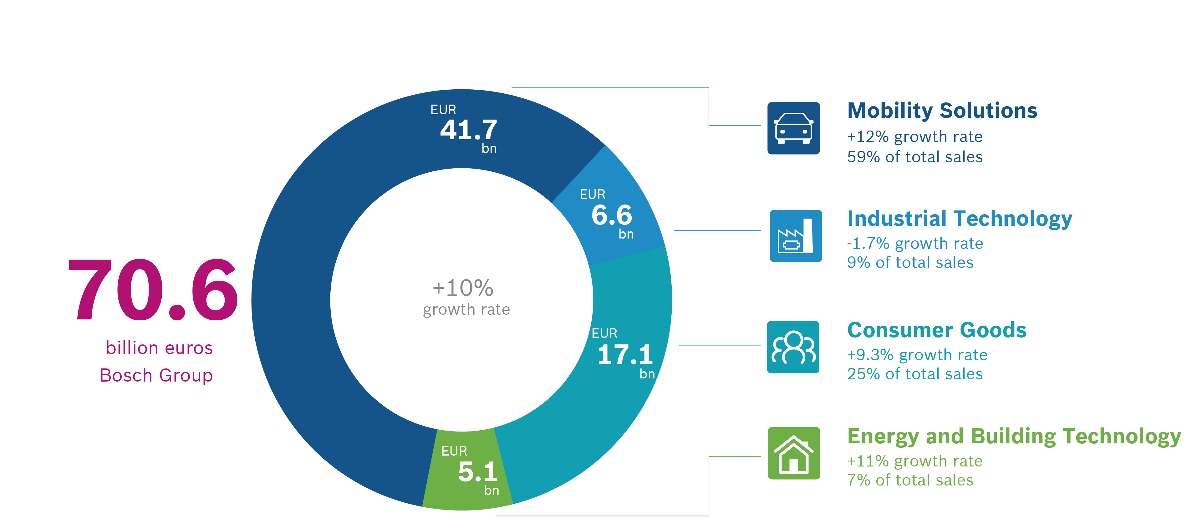
Bosch group, sectoral key data
*The recently acquired companies Robert Bosch Automotive Steering GmbH (formerly ZF Lenksysteme GmbH) and BSH Hausgeräte GmbH (formerly BSH Bosch und Siemens Hausgeräte GmbH) are fully consolidated in the 2015 figures for the first time.
6

Slide 4
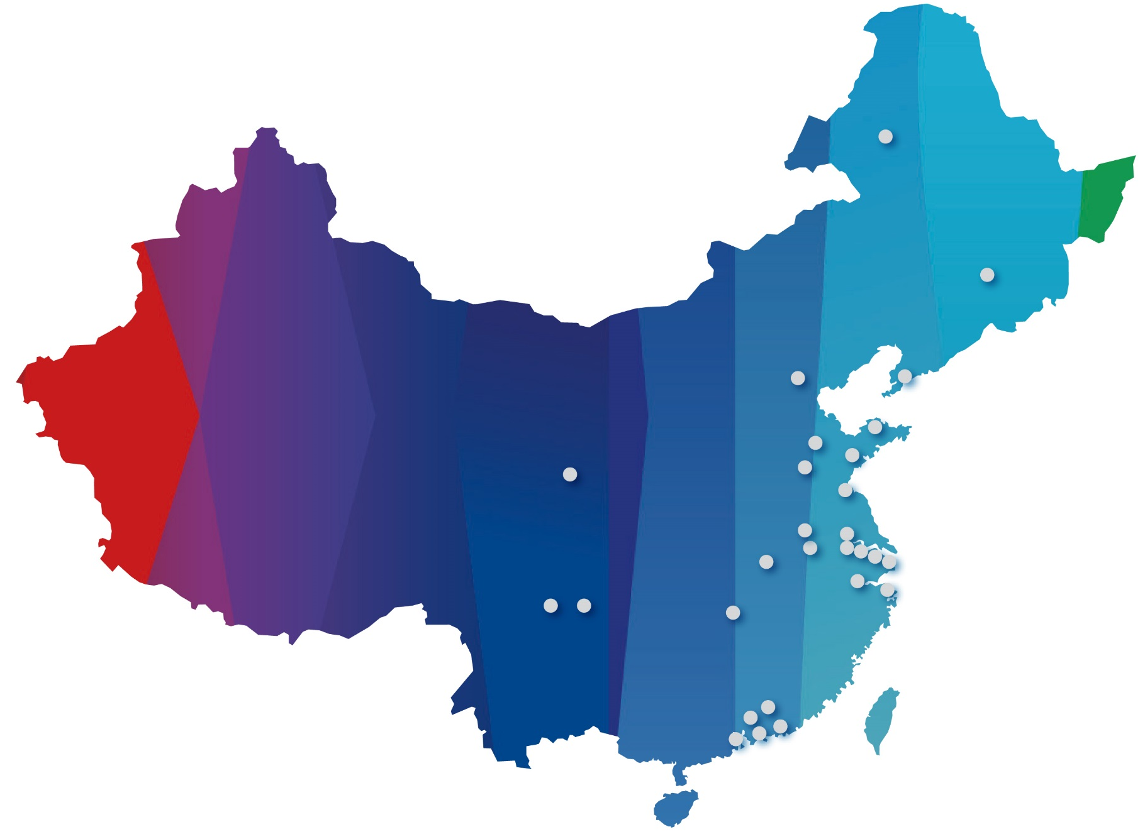
Bosch in China key data
In 2015, the sales of Bosch China kept up positive growth
billion CNY
(around 11.1 billion EUR)
62 legal entities
1 Investment holding company
48 Wholly-foreign-owned-enterprises
13 Joint ventures
Investment in China: 5.2 billion CNY in 2015; total 18 billion CNY from 2011 to 2015
Associates: 55,000 (as of December 31, 2015)
*not including Taiwan Region
13

Slide 5
Bosch NBT: New Business Team. Next Big Things?
Strategic
Customer
Product definition
Leverage Bosch’s global distribution network
Cloud
Advanced Sensors
Industry 4.0 solutions
Tech
provider
Start-ups
Service
provider
Engineering consulting
Business Development support
Investor
Minority equity investment
Joint-Ventures
Merger & Acquisitions

Slide 6
Traditional question: How to overcome innovators’ dilemma?
Performance
Progress due to
sustaining technologies
Performance
demand at developed
market
Progress due to
disruptive technologies
Performance
demand at developing
market
Time
Source: Clayton Christianson, HBR, Innovator’s Dilemma

Slide 7
Disruptions origins are often surprising
Better known competitors
  OEM: Toyota, etc.
  Tier-1 Suppliers: Continental, Delphi, etc.
  IT: Google, Baidu, etc
  High profile startups
Lesser known competitors, often surprised us

Slide 8

Artificial Intelligence innovation model: who will dominate?

Slide 9
Solutions A: plans to learn rather than plan to execute
Plan to learn
Plan to execute
Launch
Date
Incompatible?
Define target
market
Develop
product
Market
and sell
Notes:
plans of executing business goals
They are incompatible
Plan to learn:
Circular, often idiosyncratic and unexpected
Allow course corrections
Rapid iterations
Tolerate ambiguities
Freedom to explore is key
Valiant effort to fail is a badge of honor
Plan to execute
Linear, often repeatable and predictable
Minimize spec and schedule changes
Launch date further into future
Certainties are high
Process and restrictions are valued
Failures are punished

Slide 10
Zhangjiang Incubation: a case study
Venture Capital

Slide 11

MNC Incubator – roles & responsibilities
Invention
Start-ups
Product definitions
Start-ups
Sales channels
MNC
Feedback
Start-ups
MNC
MNC
VC
VC
Notes:
plans of executing business goals
They are incompatible
Plan to learn:
Circular, often idiosyncratic and unexpected
Allow course corrections
Rapid iterations
Tolerate ambiguities
Freedom to explore is key
Valiant effort to fail is a badge of honor
Plan to execute
Linear, often repeatable and predictable
Minimize spec and schedule changes
Launch date further into future
Certainties are high
Process and restrictions are valued
Failures are punished

Slide 12
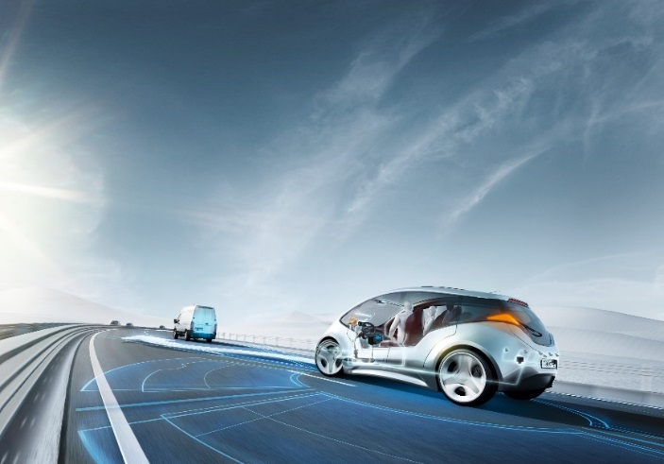
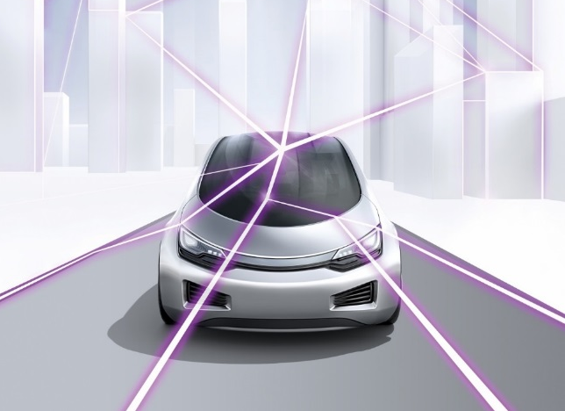
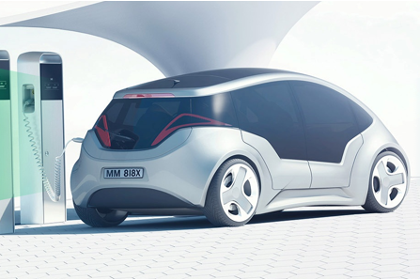
Bosch is making mobility safer, more eco-friendly and more connected
Shared
Electrification
Bosch makes electrified vehicles more eco-friendly by taking combustion engines to new heights.
Connectivity
Bosch is turning connected cars into personal assistants.
Automation
Our vision for automated driving - accident free.
16

Slide 13

IoT vision – A connected world
Bosch is leveraging our wide-ranging expertise in hardware, software, and systems to open up new areas of business and establish new business models. By doing so, Bosch is helping to shape the market and technological environment.
27

Slide 14





AI: Artificial Intelligence & Augmented Intelligence – Turning sensor data into actions
SENSORS
SENSORS
FUSION
PERCEPTION
COGNITIVE
Actions
Source: Winston, Patrick Henry, MIT
27
Notes:
What are the forces driving the idea of cognitive business?
It’s information, it’s data --
For several decades we’ve been digitizing the world; building networks to connect the world around us.
Social networks that created a whole new channel of information that runs in parallel to all other business information that’s flowing.
And with the Internet of Things, we’re connecting all of the world’s devices; applying sensors and instrumentation to all of our applications, products, operations and processes – creating connected cars, satellites, supply chains, and factories.
These are the elements of a supply chain that drives cognitive businesses:
Sensors and instruments generate the data that becomes information once analytics are applied
But we’ve reached an inflection point in which the sheer volume of information generated is so vast; we no longer have the ability to use it productively.
AI systems are knowledge systems; fueled by the magnitudes of information available to us
AI
Models targeted at making sense of the data available to us and act upon them
Representations that support Models targeted at making sense of the data available to us and act upon them
Constraints exposed by Representations that support Models targeted at making sense of the data available to us and act upon them
Algorithms enabled by Constraints exposed by Representations that support Models targeted at making sense of the data available to us and act upon them

Slide 15

Data and Tech are like Yin and Yang… and more
 | Data | Compute Power | Research | Tools | Software
Data
Compute Power
Research
Tools
Software
Substitutes
Complement

Slide 16






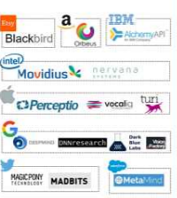
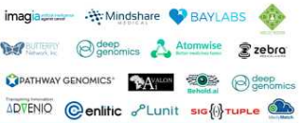


More than 60 startups applying Deep Learning…
Core AI: Computing Vision
Core AI: Other
BI, Sales & CRM
Core AI: Voice Interface
E-Commerce
Robotics & Auto
Acquired
(201402016YTD)
Deep Learning
Healthcare
Security
Other
Source:CBInsgight

Slide 17
Join the rebels
Robert Bosch (1861-1942）
30

Slide 18
Backup

Slide 19
Shaping the future
Adapt to the future
“Evolutionary innovation”
Shape the future
“Revolutionary innovation”
Most disruptive opportunities will originate externally
Win through speed, agility and flexibility in recognizing and capturing opportunities in existing markets
Play a leadership role in establishing how the industry develops

Slide 20
Development of MNC’s China Innovations
MNCs stepping into “local innovation” phase in China market
  China innovation is driven by …
  Growing number of high-quality returnees
    Trained in the Silicon Valley and returned
    Trained in MNCs and left for startups
  Massive and diverse needs
    Large population & geographical coverage create massive needs
    Unbalanced development across regions and large gap of wealth leads to diverse needs
  Determined government
    Local innovations supported by government subsidies and favorable policies
    Key and leading technology innovations (e.g. AI, aerospace, semiconductor, super-computer, etc.) held by national research institutes and PLA
  Flexible and pragmatic mindset
    Unstable market dynamic, fierce competition, and high cost pressure make Chinese end-users have a flexible and pragmatic mindset
1980’s to early 1990’s – Sold in China
  Established rep offices or sales organizations in China
Late 1990’s – Made in China
  Started local manufacturing in China
2000’s – Developed in China
  Founded local technology development in China, w/ focus on localization & technology adaptation
Now – Innovated in China
  Emphasize on technology innovation in China

